Slide 1
Today’s class
Image Formatting
Lighting’s life
Color space
Image in Matlab

Slide 2


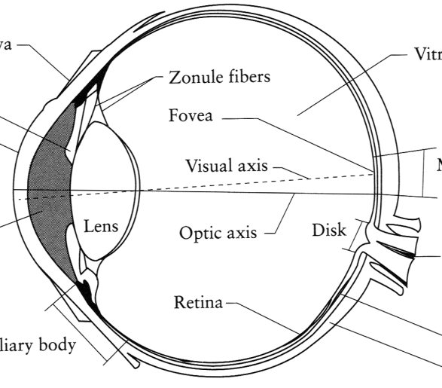
Image Formation
Digital Camera
Film
The Eye

Slide 3
A photon’s life choices
Absorption
Diffusion
Reflection
Transparency
Refraction
Fluorescence
Subsurface scattering
Phosphorescence
Interreflection
light source
λ
?

Slide 4
A photon’s life choices
Absorption
Diffusion
Reflection
Transparency
Refraction
Fluorescence
Subsurface scattering
Phosphorescence
Interreflection
light source
λ

Slide 5
A photon’s life choices
Absorption
Diffuse Reflection
Reflection
Transparency
Refraction
Fluorescence
Subsurface scattering
Phosphorescence
Interreflection
light source
λ

Slide 6
A photon’s life choices
Absorption
Diffusion
Specular Reflection
Transparency
Refraction
Fluorescence
Subsurface scattering
Phosphorescence
Interreflection
light source
λ

Slide 7
A photon’s life choices
Absorption
Diffusion
Reflection
Transparency
Refraction
Fluorescence
Subsurface scattering
Phosphorescence
Interreflection
light source
λ

Slide 8
A photon’s life choices
Absorption
Diffusion
Reflection
Transparency
Refraction
Fluorescence
Subsurface scattering
Phosphorescence
Interreflection
light source
λ

Slide 9
A photon’s life choices
Absorption
Diffusion
Reflection
Transparency
Refraction
Fluorescence
Subsurface scattering
Phosphorescence
Interreflection
light source
λ₁
λ₂

Slide 10
A photon’s life choices
Absorption
Diffusion
Reflection
Transparency
Refraction
Fluorescence
Subsurface scattering
Phosphorescence
Interreflection
light source
λ

Slide 11
A photon’s life choices
Absorption
Diffusion
Reflection
Transparency
Refraction
Fluorescence
Subsurface scattering
Phosphorescence
Interreflection
light source
t=1
t=n

Slide 12
A photon’s life choices
Absorption
Diffusion
Reflection
Transparency
Refraction
Fluorescence
Subsurface scattering
Phosphorescence
Interreflection
light source
λ
(Specular Interreflection)

Slide 13
Lambertian Reflectance
In computer vision, surfaces are often assumed to be ideal diffuse reflectors with know dependence on viewing direction.
light source
λ

Slide 14
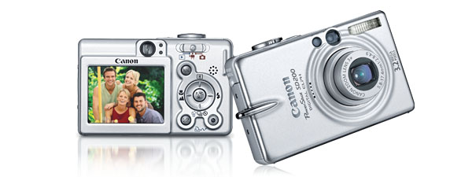
Digital camera
A digital camera replaces film with a sensor array
Each cell in the array is light-sensitive diode that converts photons to electrons
Two common types
Charge Coupled Device (CCD)
CMOS
http://electronics.howstuffworks.com/digital-camera.htm
Slide by Steve Seitz

Slide 15
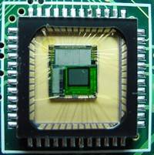
Sensor Array
CMOS sensor

Slide 16
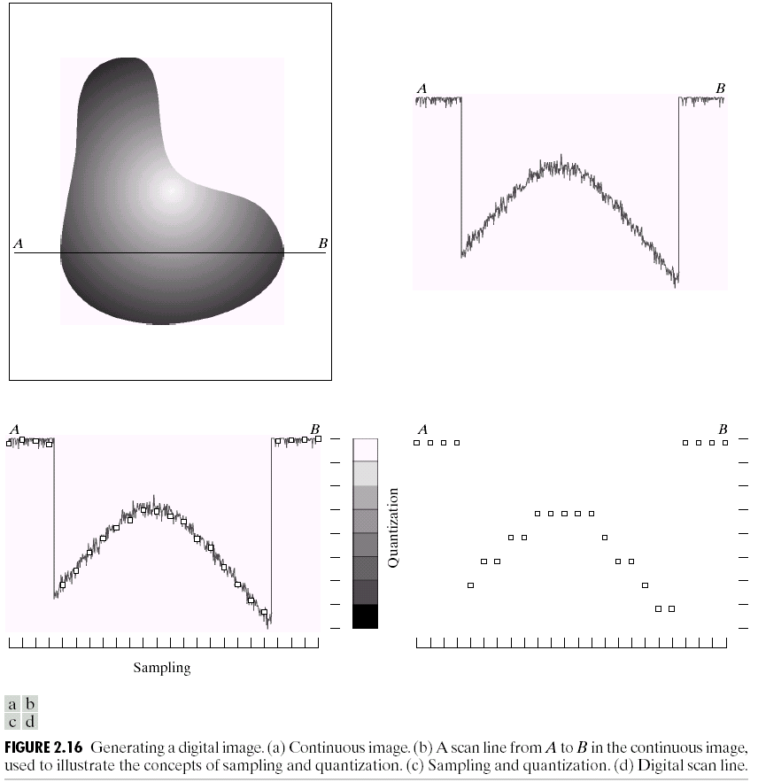
Sampling and Quantization

Slide 17
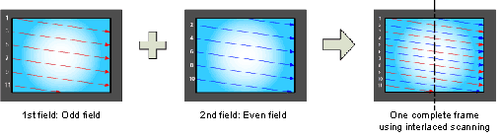
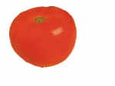
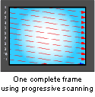
Interlace vs. progressive scan
http://www.axis.com/products/video/camera/progressive_scan.htm
Slide by Steve Seitz

Slide 18
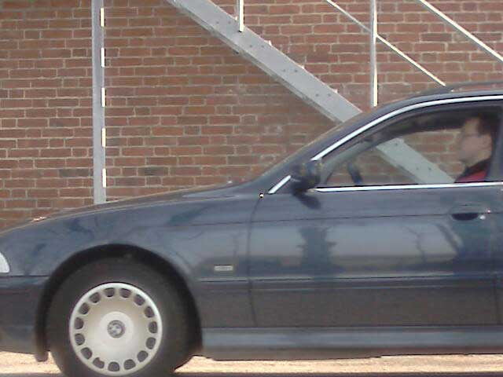
Progressive scan
http://www.axis.com/products/video/camera/progressive_scan.htm
Slide by Steve Seitz

Slide 19
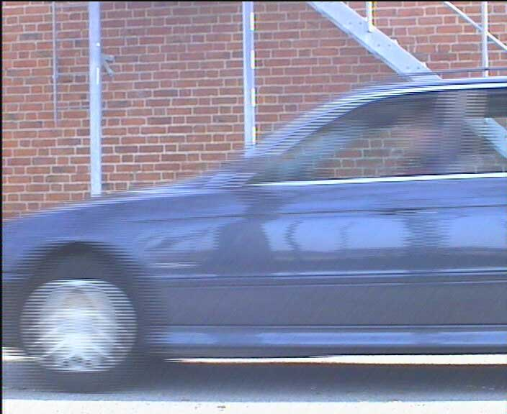
Interlace
http://www.axis.com/products/video/camera/progressive_scan.htm
Slide by Steve Seitz

Slide 20
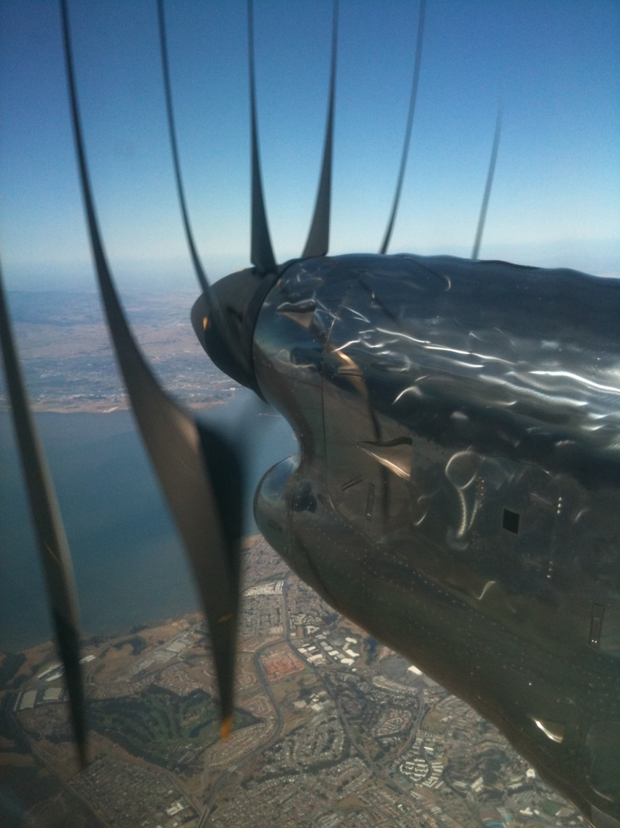
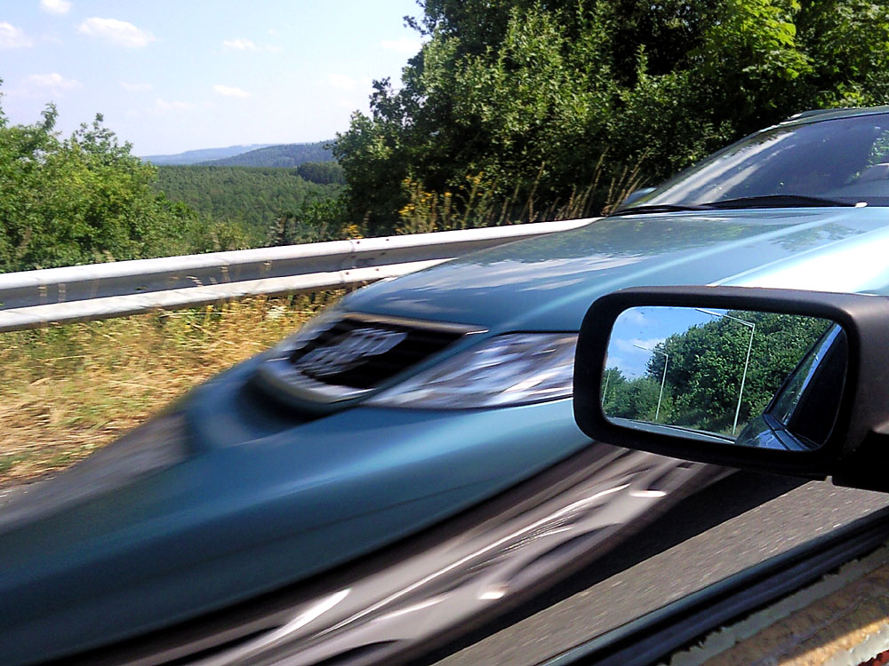
Rolling Shutter
Notes:
http://en.wikipedia.org/wiki/Rolling_shutter
Even DSLRs have this problem.

Slide 21
Have a break
Image Formatting
Next: Color Space

Slide 22
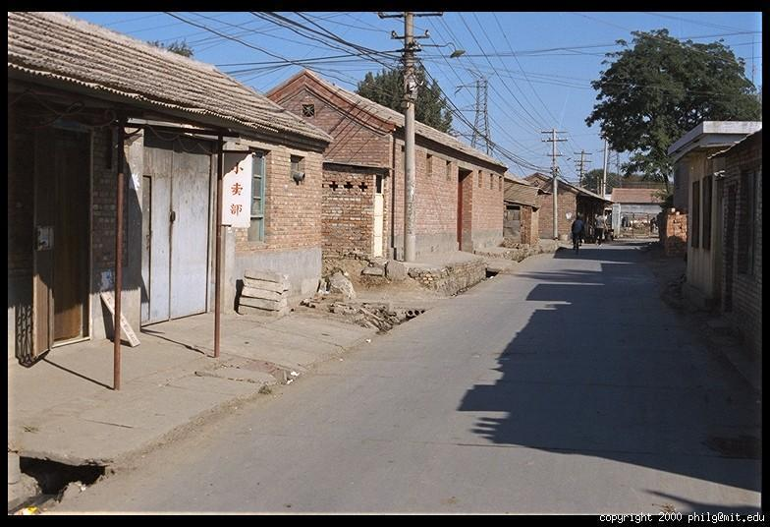
Color Image

Slide 23
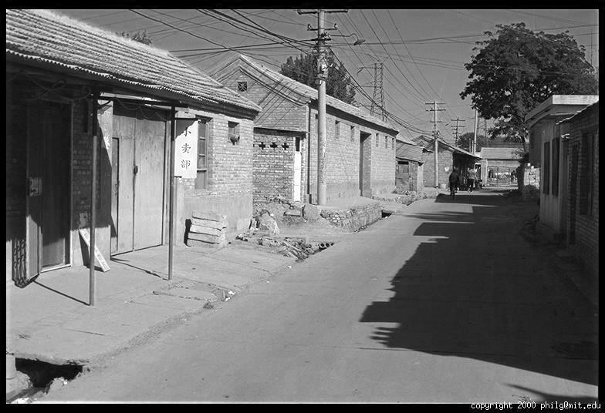
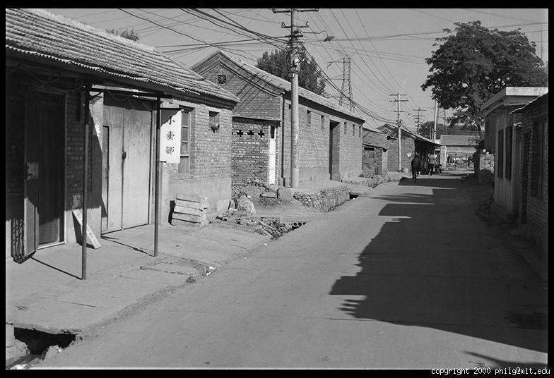
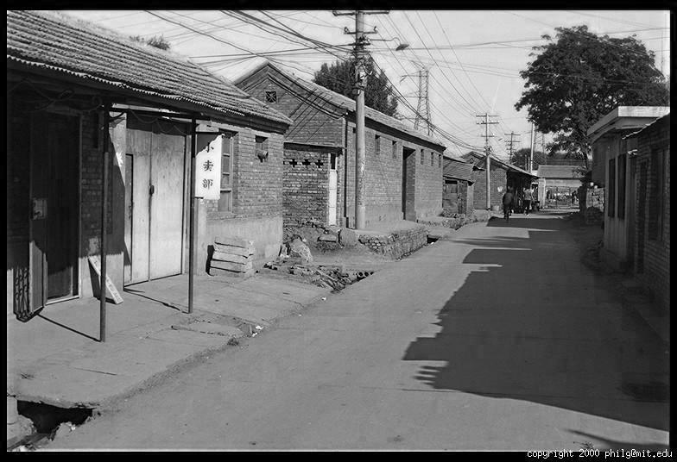
Color Image
R
G
B

Slide 24
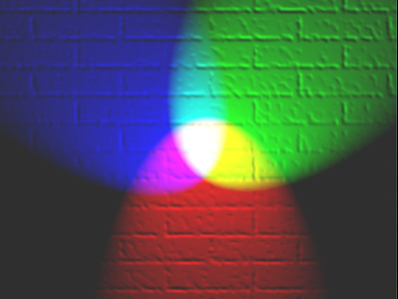
Color spaces
How can we represent color?
http://en.wikipedia.org/wiki/File:RGB_illumination.jpg

Slide 25

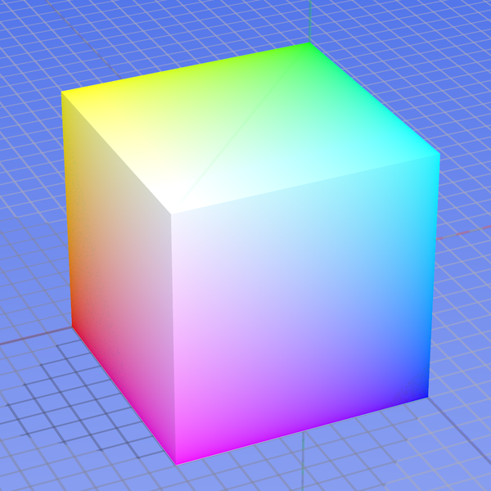
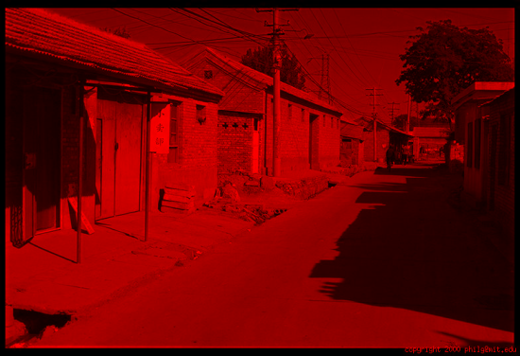
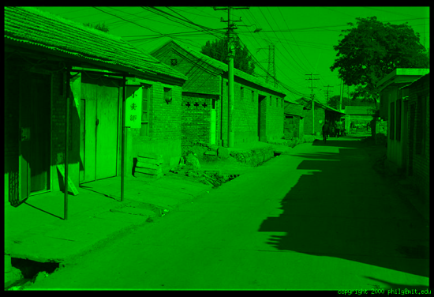
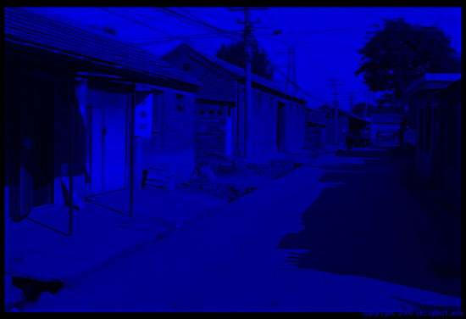
Color spaces: RGB
Default color space
0,1,0
R
(G=0,B=0)
1,0,0
G
(R=0,B=0)
0,0,1
B
(R=0,G=0)
Some drawbacks
Strongly correlated channels
Non-perceptual
Image from: http://en.wikipedia.org/wiki/File:RGB_color_solid_cube.png

Slide 26
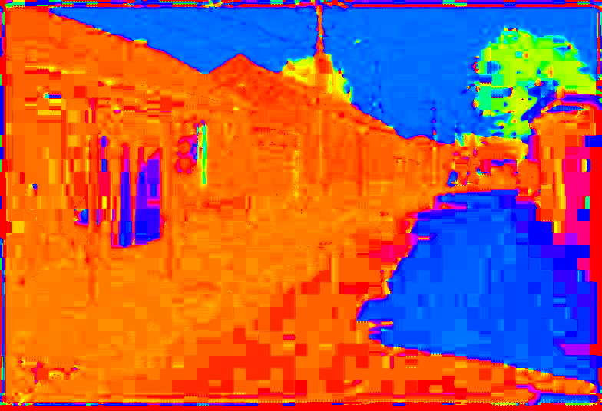
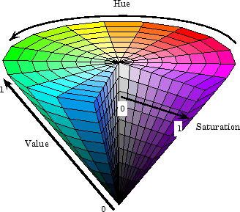
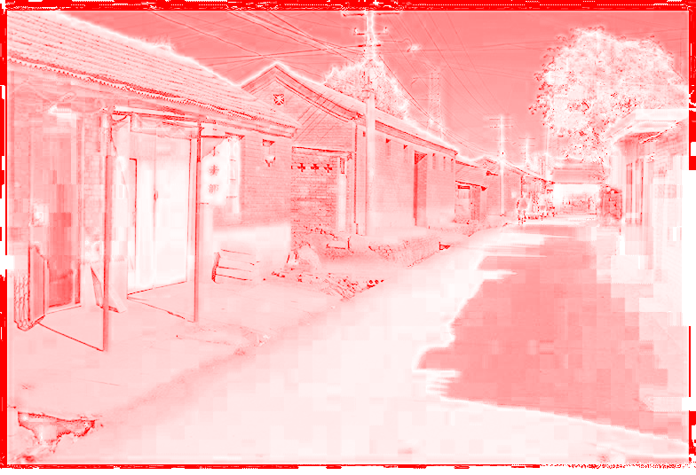
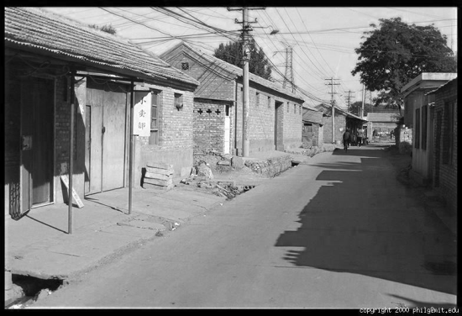
Color spaces: HSV
Intuitive color space
H
(S=1,V=1)
S
(H=1,V=1)
V
(H=1,S=0)
Notes:
The perception of color and our way of talking about it in everyday life is not well served by the RGB colorspace.
If we're thinking of repainting the walls of the living room, for example, we usually think about what shade of color it should be, how bright we want it, and whether it should be pastel or vivid.
H: Hue describes the shade of color and where that color it is found in the color spectrum. Red, yellow, and purple are words that describe hue. Figure 5.3
A pure red that has no white is 100% saturated.
S. The saturation describes how pure the hue is with respect to a white reference. For example, a color that is all red and no white is fully saturated. If we add some white to the red, the result becomes more pastel, and the color shifts from red to pink. The hue is still red but it has become less saturated. This is illustrated in the vertical bar of Figure 5.3. Saturation is a percentage that ranges from 0 to 100. A pure red that has no white is 100% saturated.
Finally, a color also has a brightness.
This is a relative description of how much light is coming from the color. If the color reflects a lot of light, we would say that it is bright. Imagine seeing a red sportscar during the day. Its color looks bright. Compare this with the perception of the car as night is falling. We can see that the car is red but it looks duller because ambient illumination is reflecting less light into the eye. Less light means the color looks darker. In the GIMP, the most important measure of brightness is measured by a quantity called value. However, there are also other measures of brightness that will be introduced shortly. For the moment, though, the horizontal bar in Figure 5.3 illustrates a range of red values. Value, like saturation, is a percentage that goes from 0 to 100. This range can be thought of as the amount of light illuminating a color. For example, when the hue is red and the value is high the color looks bright. When the value is low it looks dark.

Slide 27
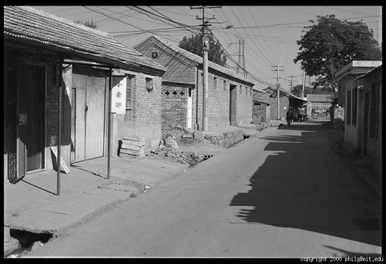





Color spaces: YCbCr
Fast to compute, good for compression, used by TV
Y=0
Y=0.5
Y
(Cb=0.5,Cr=0.5)
Cr
Cb
(Y=0.5,Cr=0.5)
Cb
Y=1
Cr
(Y=0.5,Cb=05)

Slide 28
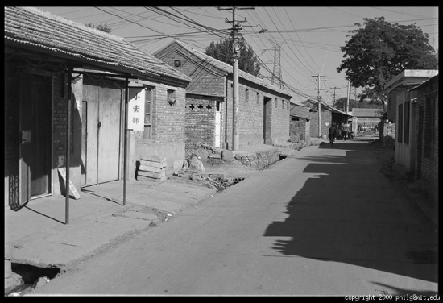
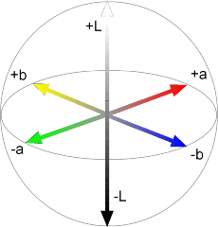
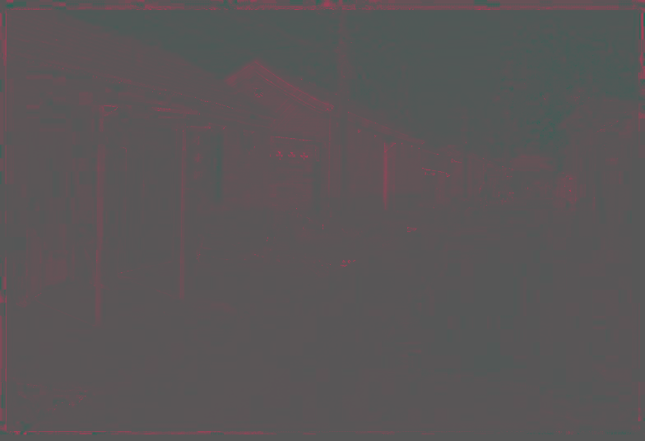
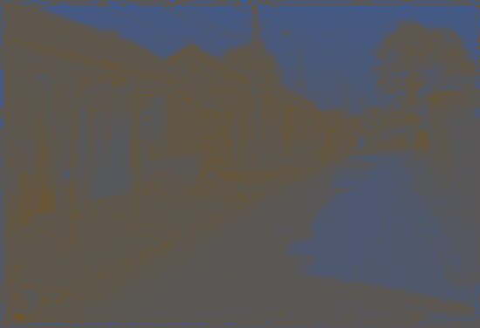
Color spaces: L*a*b*
“Perceptually uniform”* color space
L
(a=0,b=0)
a
(L=65,b=0)
b
(L=65,a=0)

Slide 29
If you had to choose, would you rather go without luminance or chrominance?

Slide 30
If you had to choose, would you rather go without luminance or chrominance?

Slide 31
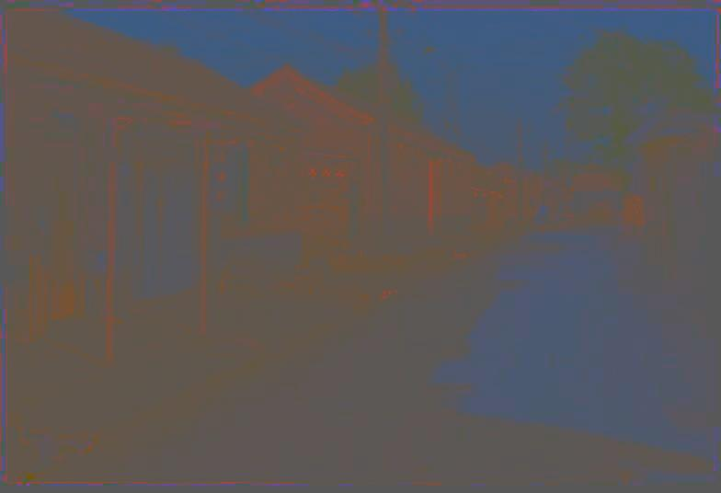
Most information in intensity
Only color shown – constant intensity

Slide 32

Most information in intensity
Only intensity shown – constant color

Slide 33
Most information in intensity
Original image

Slide 34
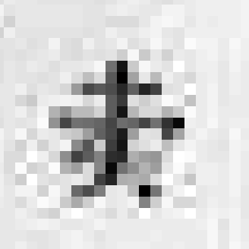
Back to grayscale intensity
0.92 | 0.93 | 0.94 | 0.97 | 0.62 | 0.37 | 0.85 | 0.97 | 0.93 | 0.92 | 0.99
0.95 | 0.89 | 0.82 | 0.89 | 0.56 | 0.31 | 0.75 | 0.92 | 0.81 | 0.95 | 0.91
0.89 | 0.72 | 0.51 | 0.55 | 0.51 | 0.42 | 0.57 | 0.41 | 0.49 | 0.91 | 0.92
0.96 | 0.95 | 0.88 | 0.94 | 0.56 | 0.46 | 0.91 | 0.87 | 0.90 | 0.97 | 0.95
0.71 | 0.81 | 0.81 | 0.87 | 0.57 | 0.37 | 0.80 | 0.88 | 0.89 | 0.79 | 0.85
0.49 | 0.62 | 0.60 | 0.58 | 0.50 | 0.60 | 0.58 | 0.50 | 0.61 | 0.45 | 0.33
0.86 | 0.84 | 0.74 | 0.58 | 0.51 | 0.39 | 0.73 | 0.92 | 0.91 | 0.49 | 0.74
0.96 | 0.67 | 0.54 | 0.85 | 0.48 | 0.37 | 0.88 | 0.90 | 0.94 | 0.82 | 0.93
0.69 | 0.49 | 0.56 | 0.66 | 0.43 | 0.42 | 0.77 | 0.73 | 0.71 | 0.90 | 0.99
0.79 | 0.73 | 0.90 | 0.67 | 0.33 | 0.61 | 0.69 | 0.79 | 0.73 | 0.93 | 0.97
0.91 | 0.94 | 0.89 | 0.49 | 0.41 | 0.78 | 0.78 | 0.77 | 0.89 | 0.99 | 0.93

Slide 35
Images in Matlab
Images represented as a matrix
Suppose we have a NxM RGB image called “im”
im(1,1,1) = top-left pixel value in R-channel
im(y, x, b) = y pixels down, x pixels to right in the b^{th} channel
im(N, M, 3) = bottom-right pixel in B-channel
imread(filename) returns a uint8 image (values 0 to 255)
Convert to double format (values 0 to 1) with im2double
column
row
R
0.92 | 0.93 | 0.94 | 0.97 | 0.62 | 0.37 | 0.85 | 0.97 | 0.93 | 0.92 | 0.99
0.95 | 0.89 | 0.82 | 0.89 | 0.56 | 0.31 | 0.75 | 0.92 | 0.81 | 0.95 | 0.91
0.89 | 0.72 | 0.51 | 0.55 | 0.51 | 0.42 | 0.57 | 0.41 | 0.49 | 0.91 | 0.92
0.96 | 0.95 | 0.88 | 0.94 | 0.56 | 0.46 | 0.91 | 0.87 | 0.90 | 0.97 | 0.95
0.71 | 0.81 | 0.81 | 0.87 | 0.57 | 0.37 | 0.80 | 0.88 | 0.89 | 0.79 | 0.85
0.49 | 0.62 | 0.60 | 0.58 | 0.50 | 0.60 | 0.58 | 0.50 | 0.61 | 0.45 | 0.33
0.86 | 0.84 | 0.74 | 0.58 | 0.51 | 0.39 | 0.73 | 0.92 | 0.91 | 0.49 | 0.74
0.96 | 0.67 | 0.54 | 0.85 | 0.48 | 0.37 | 0.88 | 0.90 | 0.94 | 0.82 | 0.93
0.69 | 0.49 | 0.56 | 0.66 | 0.43 | 0.42 | 0.77 | 0.73 | 0.71 | 0.90 | 0.99
0.79 | 0.73 | 0.90 | 0.67 | 0.33 | 0.61 | 0.69 | 0.79 | 0.73 | 0.93 | 0.97
0.91 | 0.94 | 0.89 | 0.49 | 0.41 | 0.78 | 0.78 | 0.77 | 0.89 | 0.99 | 0.93
G
0.92 | 0.93 | 0.94 | 0.97 | 0.62 | 0.37 | 0.85 | 0.97 | 0.93 | 0.92 | 0.99
0.95 | 0.89 | 0.82 | 0.89 | 0.56 | 0.31 | 0.75 | 0.92 | 0.81 | 0.95 | 0.91
0.89 | 0.72 | 0.51 | 0.55 | 0.51 | 0.42 | 0.57 | 0.41 | 0.49 | 0.91 | 0.92
0.96 | 0.95 | 0.88 | 0.94 | 0.56 | 0.46 | 0.91 | 0.87 | 0.90 | 0.97 | 0.95
0.71 | 0.81 | 0.81 | 0.87 | 0.57 | 0.37 | 0.80 | 0.88 | 0.89 | 0.79 | 0.85
0.49 | 0.62 | 0.60 | 0.58 | 0.50 | 0.60 | 0.58 | 0.50 | 0.61 | 0.45 | 0.33
0.86 | 0.84 | 0.74 | 0.58 | 0.51 | 0.39 | 0.73 | 0.92 | 0.91 | 0.49 | 0.74
0.96 | 0.67 | 0.54 | 0.85 | 0.48 | 0.37 | 0.88 | 0.90 | 0.94 | 0.82 | 0.93
0.69 | 0.49 | 0.56 | 0.66 | 0.43 | 0.42 | 0.77 | 0.73 | 0.71 | 0.90 | 0.99
0.79 | 0.73 | 0.90 | 0.67 | 0.33 | 0.61 | 0.69 | 0.79 | 0.73 | 0.93 | 0.97
0.91 | 0.94 | 0.89 | 0.49 | 0.41 | 0.78 | 0.78 | 0.77 | 0.89 | 0.99 | 0.93
B
0.92 | 0.93 | 0.94 | 0.97 | 0.62 | 0.37 | 0.85 | 0.97 | 0.93 | 0.92 | 0.99
0.95 | 0.89 | 0.82 | 0.89 | 0.56 | 0.31 | 0.75 | 0.92 | 0.81 | 0.95 | 0.91
0.89 | 0.72 | 0.51 | 0.55 | 0.51 | 0.42 | 0.57 | 0.41 | 0.49 | 0.91 | 0.92
0.96 | 0.95 | 0.88 | 0.94 | 0.56 | 0.46 | 0.91 | 0.87 | 0.90 | 0.97 | 0.95
0.71 | 0.81 | 0.81 | 0.87 | 0.57 | 0.37 | 0.80 | 0.88 | 0.89 | 0.79 | 0.85
0.49 | 0.62 | 0.60 | 0.58 | 0.50 | 0.60 | 0.58 | 0.50 | 0.61 | 0.45 | 0.33
0.86 | 0.84 | 0.74 | 0.58 | 0.51 | 0.39 | 0.73 | 0.92 | 0.91 | 0.49 | 0.74
0.96 | 0.67 | 0.54 | 0.85 | 0.48 | 0.37 | 0.88 | 0.90 | 0.94 | 0.82 | 0.93
0.69 | 0.49 | 0.56 | 0.66 | 0.43 | 0.42 | 0.77 | 0.73 | 0.71 | 0.90 | 0.99
0.79 | 0.73 | 0.90 | 0.67 | 0.33 | 0.61 | 0.69 | 0.79 | 0.73 | 0.93 | 0.97
0.91 | 0.94 | 0.89 | 0.49 | 0.41 | 0.78 | 0.78 | 0.77 | 0.89 | 0.99 | 0.93

Slide 36
Next Lecture
Image Filtering - the core idea for project 2, and all of image processing.

Slide 37
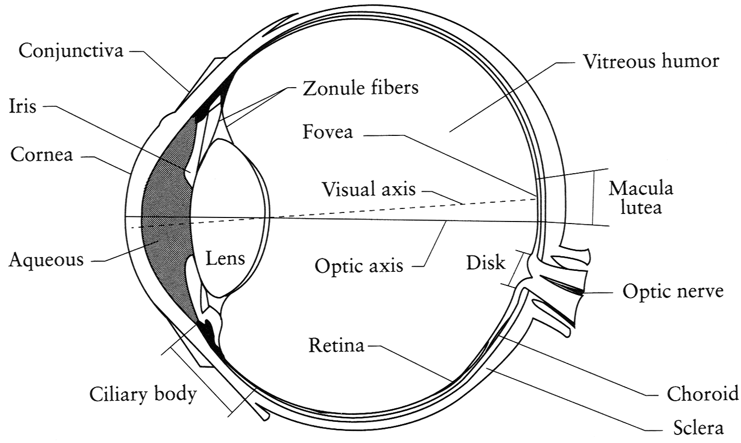
The Eye
The human eye is a camera!
Iris - colored annulus with radial muscles
Pupil - the hole (aperture) whose size is controlled by the iris
What’s the “film”?
photoreceptor cells (rods and cones) in the retina
Slide by Steve Seitz

Slide 38
The Retina

Slide 39
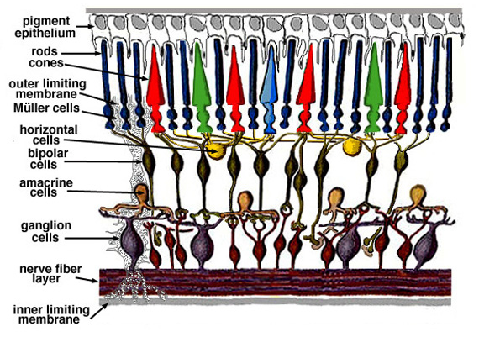
Retina up-close
Light
Notes:
Tapetum lucidum

Slide 40
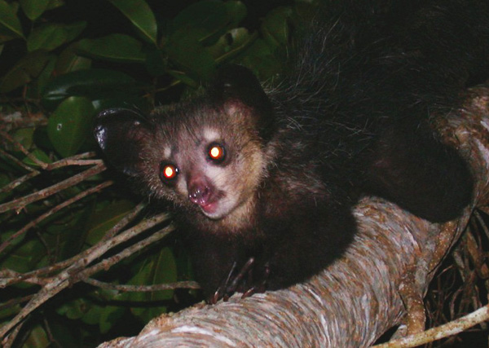
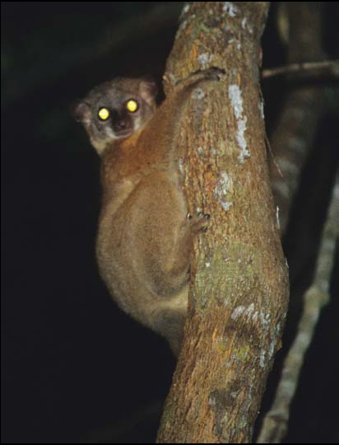
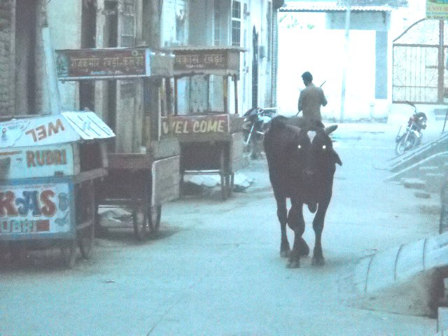
What humans don’t have: tapetum lucidum
Notes:
Animals with Tapetum Lucidum also have RPE, just not in the same part of the eye.

Slide 41
Two types of light-sensitive receptors
Cones
cone-shaped
less sensitive
operate in high light
color vision
Rods
rod-shaped
highly sensitive
operate at night
gray-scale vision
© Stephen E. Palmer, 2002

Slide 42
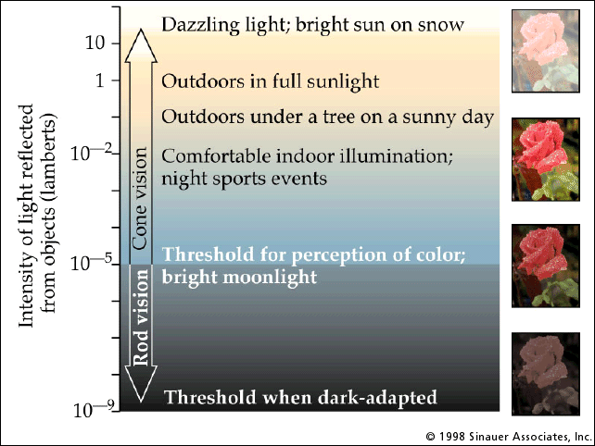
Rod / Cone sensitivity

Slide 43
Distribution of Rods and Cones
Night Sky: why are there more stars off-center? Averted vision: http://en.wikipedia.org/wiki/Averted_vision
© Stephen E. Palmer, 2002

Slide 44
Eye Movements
Saccades
Can be consciously controlled. Related to perceptual attention.
200ms to initiation, 20 to 200ms to carry out. Large amplitude.
Microsaccades
Involuntary. Smaller amplitude. Especially evident during prolonged fixation. Function debated.
Ocular microtremor (OMT)
involuntary. high frequency (up to 80Hz), small amplitude.

Slide 45
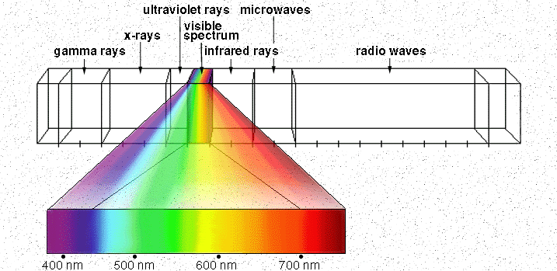
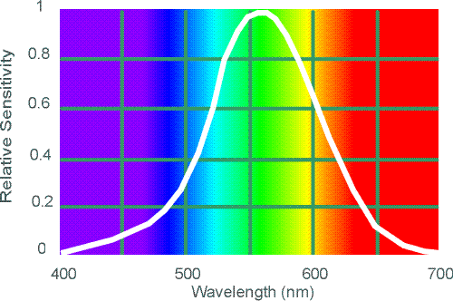
Electromagnetic Spectrum
Human Luminance Sensitivity Function
http://www.yorku.ca/eye/photopik.htm
Notes:
At least 3 spectral bands required (e.g. R,G,B)

Slide 46
Visible Light
Why do we see light of these wavelengths?
…because that’s where the
Sun radiates EM energy
© Stephen E. Palmer, 2002
Notes:
Because that’s where the Sun’s peak radiation was
Because the atmosphere is fairly transparent in that range
Because biology has many important markers in that range (but that’s because of the previous two reasons)

Slide 47
The Physics of Light
Any patch of light can be completely described
physically by its spectrum: the number of photons
(per time unit) at each wavelength 400 - 700 nm.
© Stephen E. Palmer, 2002

Slide 48
The Physics of Light
Some examples of the spectra of light sources
© Stephen E. Palmer, 2002

Slide 49
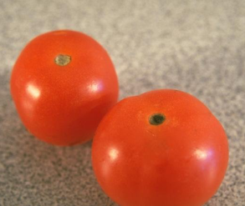
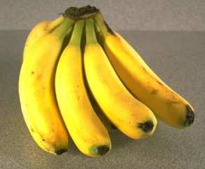
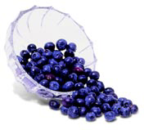
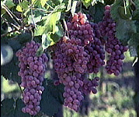
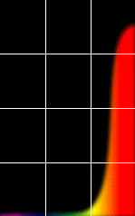
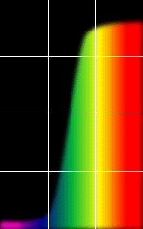
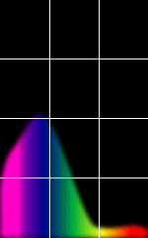
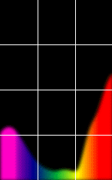
The Physics of Light
Some examples of the reflectance spectra of surfaces
Red
Yellow
Blue
Purple
% Photons Reflected
400 700
400 700
400 700
400 700
Wavelength (nm)
© Stephen E. Palmer, 2002

Slide 50
The Psychophysical Correspondence
There is no simple functional description for the perceived
color of all lights under all viewing conditions, but …...
A helpful constraint:
Consider only physical spectra with normal distributions
mean
area
variance
© Stephen E. Palmer, 2002

Slide 51
The Psychophysical Correspondence
Mean
Hue
# Photons
Wavelength
© Stephen E. Palmer, 2002

Slide 52
The Psychophysical Correspondence
Variance
Saturation
# Photons
Wavelength
© Stephen E. Palmer, 2002

Slide 53
The Psychophysical Correspondence
Area
Brightness
# Photons
Wavelength
© Stephen E. Palmer, 2002

Slide 54
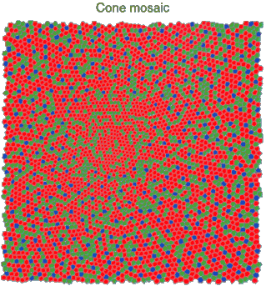
Physiology of Color Vision
Three kinds of cones:
Why are M and L cones so close?
Why are there 3?
© Stephen E. Palmer, 2002

Slide 55


Impossible Colors
Can you make the cones respond in ways that typical light spectra never would?
http://en.wikipedia.org/wiki/Impossible_colors

Slide 56
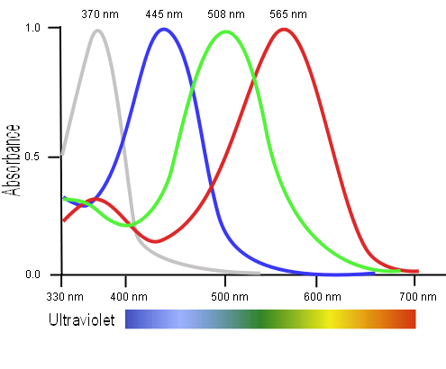
Tetrachromatism
Bird cone responses
Most birds, and many other animals, have cones for ultraviolet light.
Some humans, mostly female, seem to have slight tetrachromatism.

Slide 57
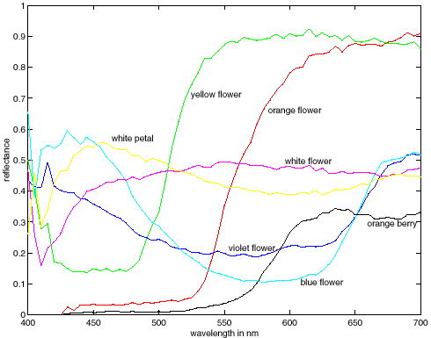
More Spectra
metamers
Notes:
Metamerism can be illuminant based or observer based. Color blindness produced well known instances of metamerism.

Slide 58


Color Sensing in Camera (RGB)
3-chip vs. 1-chip: quality vs. cost
Why more green?
Why 3 colors?
http://www.cooldictionary.com/words/Bayer-filter.wikipedia
Slide by Steve Seitz

Slide 59


Practical Color Sensing: Bayer Grid
Estimate RGB at ‘G’ cells from neighboring values
Slide by Steve Seitz

